Slide 1
Data structure and Algorithm Lesson 4: Stack and Queue
DII Summer 2021
By Aj.Suttinee

Slide 2
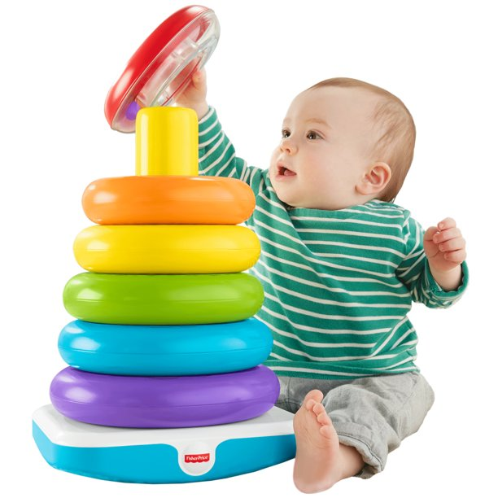
Stack
Stack is an important concept in general programming

Slide 3
Stack
Stack is a memory list, e.g. array or linked list.
Last-In-First-Out (LIFO) structure
Fundamental operations on a stack
Push = insert a new element in to the list
Pop = delete the most recently inserted element from the list
A[0] | A[1] | A[2] | A[3] | A[4] | A[5] | A[6] | A[7] | A[8] | A[9]

Slide 4
Stack
TOP
5
A[0] | A[1] | A[2] | A[3] | A[4] | A[5] | A[6] | A[7] | A[8] | A[9]
Push(stack, 5);

Slide 5
Stack
TOP
5 | 3
A[0] | A[1] | A[2] | A[3] | A[4] | A[5] | A[6] | A[7] | A[8] | A[9]
Push(stack, 5);
Push(stack, 3);

Slide 6
Stack
TOP
5 | 3 | 4
A[0] | A[1] | A[2] | A[3] | A[4] | A[5] | A[6] | A[7] | A[8] | A[9]
Push(stack, 5);
Push(stack, 3);
Push(stack, 4);

Slide 7
Stack
TOP
5 | 3
A[0] | A[1] | A[2] | A[3] | A[4] | A[5] | A[6] | A[7] | A[8] | A[9]
Push(stack, 5);
Push(stack, 3);
Push(stack, 4);
Pop(stack);

Slide 8
Stack
TOP
5 | 3 | 9
A[0] | A[1] | A[2] | A[3] | A[4] | A[5] | A[6] | A[7] | A[8] | A[9]
Push(stack, 5);
Push(stack, 3);
Push(stack, 4);
Pop(stack);
Push(stack, 9);
Push(stack, 7);

Slide 9
Stack
TOP
5 | 3 | 9 | 7
A[0] | A[1] | A[2] | A[3] | A[4] | A[5] | A[6] | A[7] | A[8] | A[9]
Push(stack, 5);
Push(stack, 3);
Push(stack, 4);
Pop(stack);
Push(stack, 9);
Push(stack, 7);

Slide 10
Stack
To create our own stack:
Create an array
Create a push method
Create a pop method
Create a display stack method
Create a peek method (display the top of stack)
When your stack is full, you must display a warning
If you have time, you may create a method to create a new array with wider length, then copy all the elements to the new array.

Slide 11
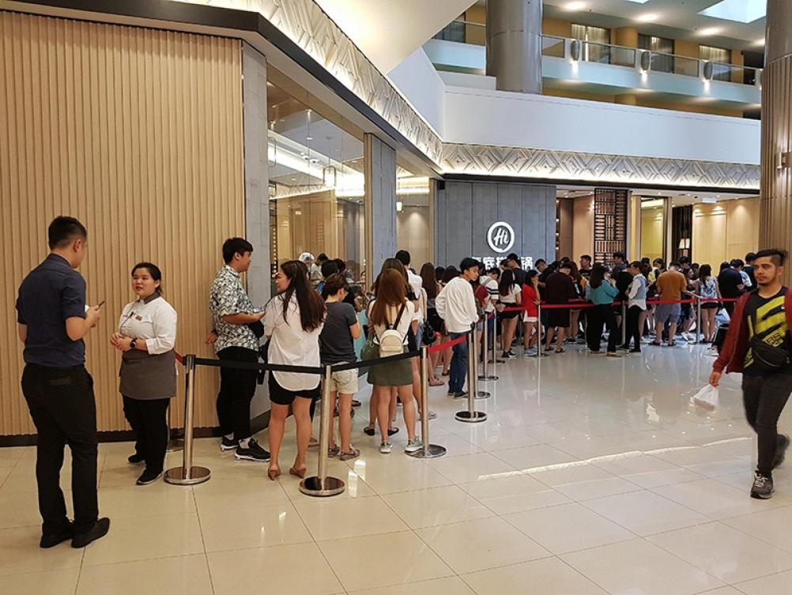

Queue

Slide 12
Queue
Queue is also a memory list, e.g. array or linked list.
First-In-First-Out (FIFO) structure
Fundamental operations on a stack
enQueue = insert a new element in to the list
deQueue = delete the first inserted element from the list
A[0] | A[1] | A[2] | A[3] | A[4] | A[5] | A[6] | A[7] | A[8] | A[9]

Slide 13
Queue
FRONT
5
A[0] | A[1] | A[2] | A[3] | A[4] | A[5] | A[6] | A[7] | A[8] | A[9]
REAR
Push(queue, 5);

Slide 14
Queue
FRONT
5 | 7
A[0] | A[1] | A[2] | A[3] | A[4] | A[5] | A[6] | A[7] | A[8] | A[9]
REAR
enQueue(queue, 5);
enQueue(queue, 7);

Slide 15
Queue
FRONT
5 | 7 | 1
A[0] | A[1] | A[2] | A[3] | A[4] | A[5] | A[6] | A[7] | A[8] | A[9]
REAR
enQueue(queue, 5);
enQueue(queue, 7);
enQueue(queue, 1);

Slide 16
Queue
FRONT
5 | 7 | 1
A[0] | A[1] | A[2] | A[3] | A[4] | A[5] | A[6] | A[7] | A[8] | A[9]
REAR
enQueue(queue, 5);
enQueue(queue, 7);
enQueue(queue, 1);
deQueue(queue);

Slide 17
Queue
FRONT
7 | 1
A[0] | A[1] | A[2] | A[3] | A[4] | A[5] | A[6] | A[7] | A[8] | A[9]
REAR
enQueue(queue, 5);
enQueue(queue, 7);
enQueue(queue, 1);
deQueue(queue);

Slide 18
Queue
FRONT
 | 7 | 1
A[0] | A[1] | A[2] | A[3] | A[4] | A[5] | A[6] | A[7] | A[8] | A[9]
REAR
enQueue(queue, 5);
enQueue(queue, 7);
enQueue(queue, 1);
deQueue(queue);

Slide 19
When queue is full ?
FRONT
 |  |  |  |  |  |  |  | 7 | 1
A[0] | A[1] | A[2] | A[3] | A[4] | A[5] | A[6] | A[7] | A[8] | A[9]
REAR
enQueue(queue, 5);
enQueue(queue, 7);
enQueue(queue, 1);
deQueue(queue);

